Slide 1
Welcome

Slide 2
Reducing of bad flute and damage rejection value in drill
Presented by: Wanjari Vikrant Changdev
Khotare Hiraman Kashinath
Guided by: Prof. R.G. Pungle
P.E.S. College Of Engineering, Aurangabad
Mechanical Department
Year 2016-17

Slide 3
Content
Introduction
Project Background
Manufacturing process for twist drill
Pareto Analysis
Cause and effect analysis
Control chats
Countermeasure actions for significant root causes
Conclusion

Slide 4
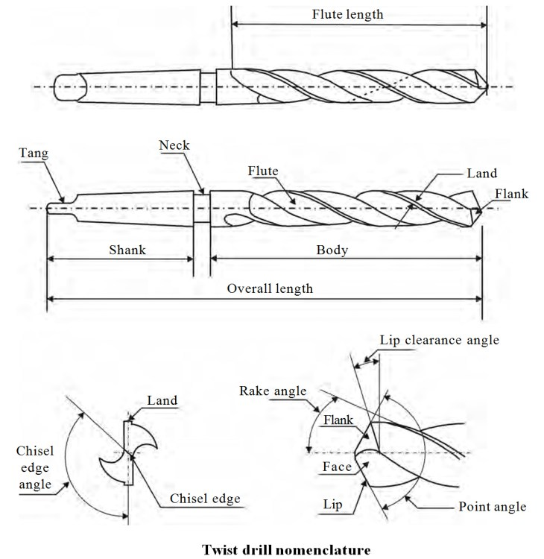
INTRODUCTION
Drilling:drilling is the most common of machining operations performed in industry.
Nomenclature of Twist Drill

Slide 5
Material Used For Manufacturing Twist Drill
1.Carbon Steels
2.High Speed Steel
a)M2-high wear resistance
b)M35-similar to M2, but with 5% cobalt added’ It will cut faster and last longer than M2.
c)M42-with an additional 8% or 10% cobalt’ superior red-hardness
d)T42-high temperature strength of the matrix, form special carbides of great hardness

Slide 6
PROJECT BACKGROUND
Indian Tool Manufacturers (ITM) - A Division of Birla Precision Technologies Ltd Aurangabad last year total drills produced value was 3526 lakhs In that (Bad flute and damage) defect rejection value is 15.58 lakhs which is contributed 0.44 %. This is one of the top defect in drills.
Problem Statement
After analysis of final inspection report data rejection due to bad flute & damage comes out one of the major defect. It is 0.44% of packing value. Due to this throughput Jobber production is affected.

Slide 7
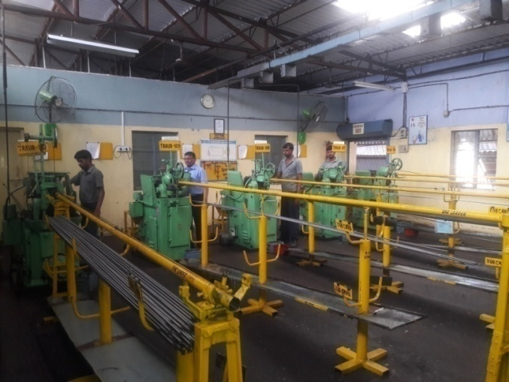
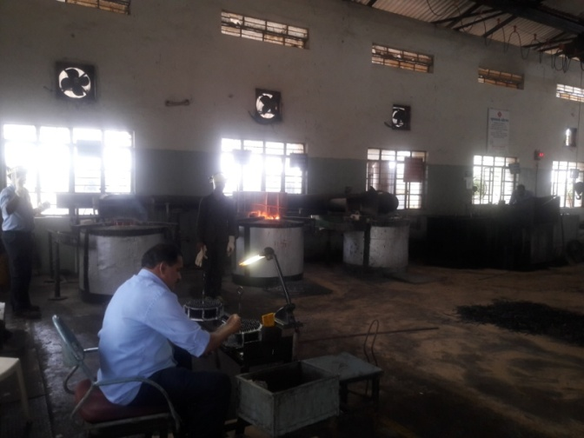
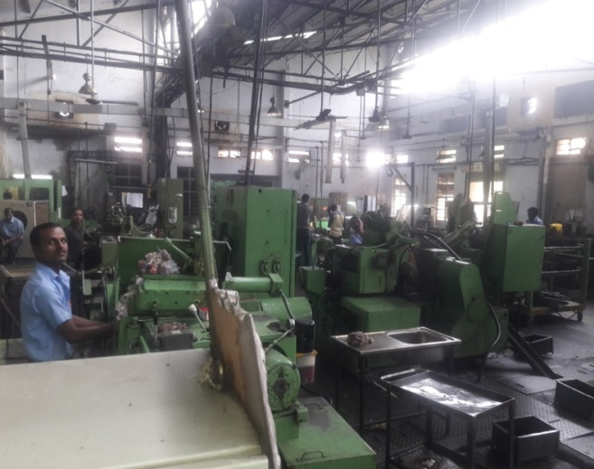
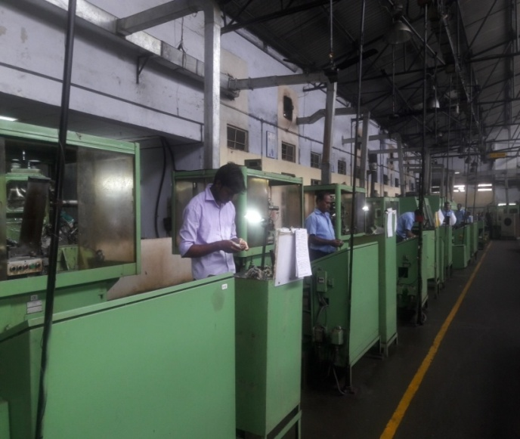
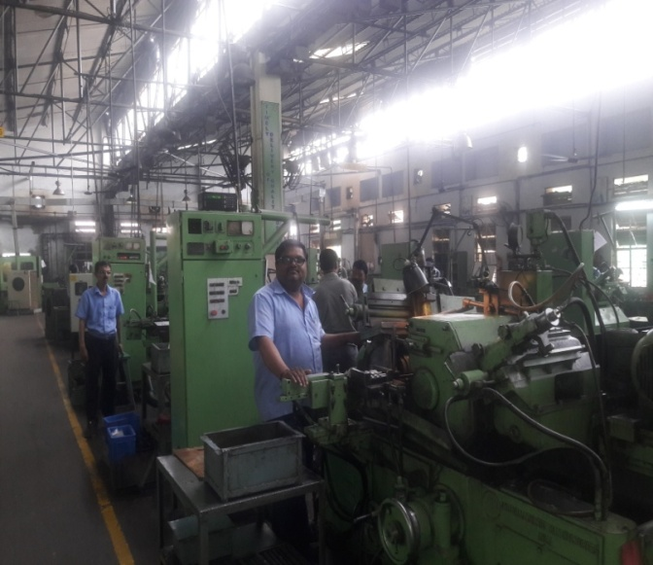
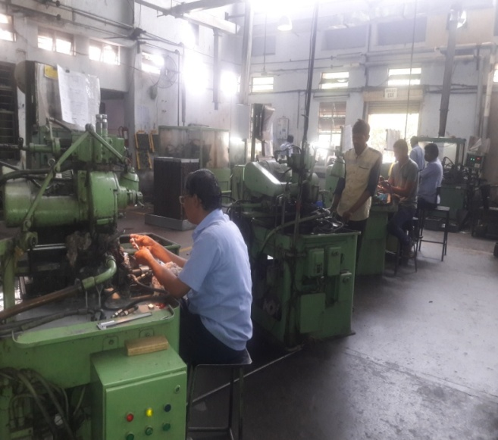
TWIST DRILL BIT MANUFACTURING PROCESS
Cutting
H T
Blank Grinding
Flute Grinding
Size/Finish Grinding
Clearance Grinding

Slide 8
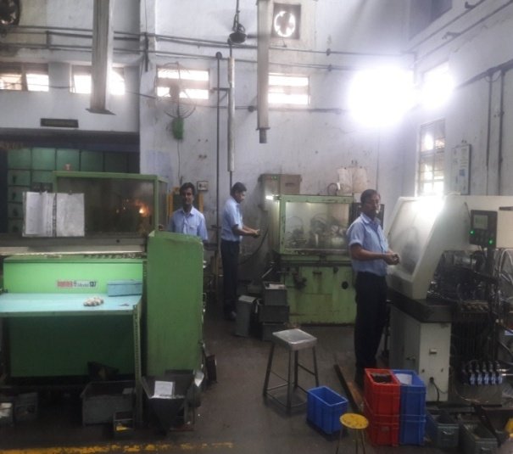
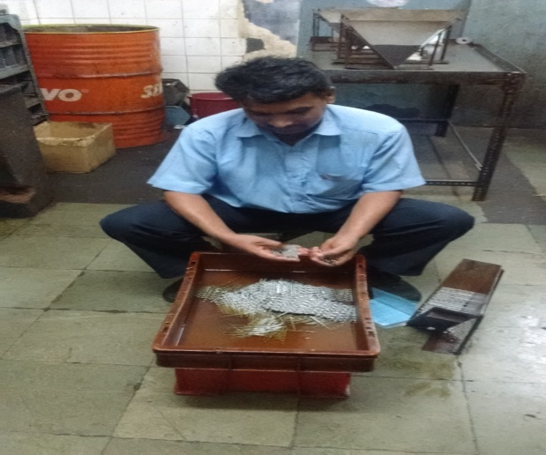
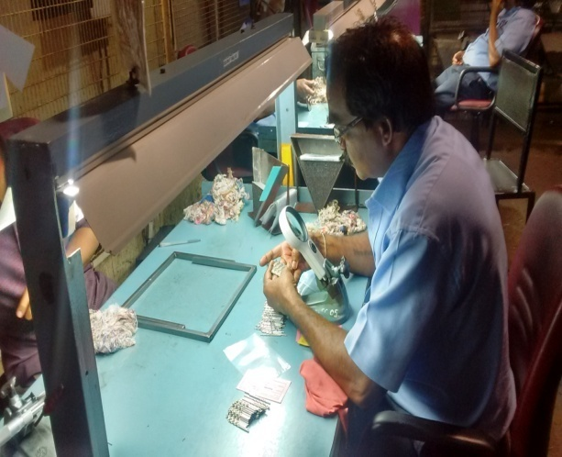
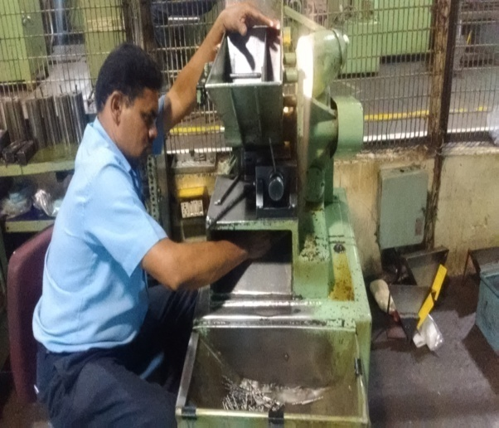
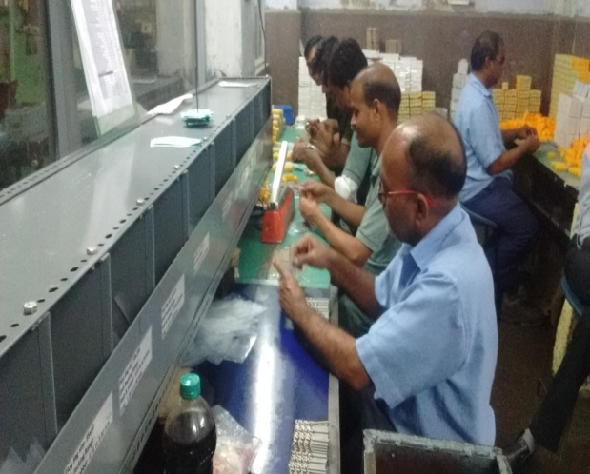
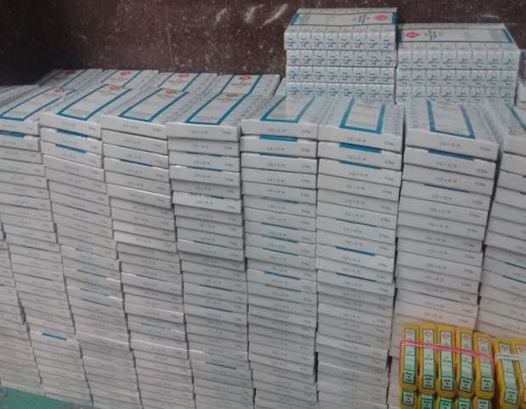
Point Grinding
Cleaning
Final Inspection
Marking
Packing
FGS

Slide 9
PARETO ANALYSIS
Pareto Chart For Defects In Drill:

Slide 10
CAUSE AND EFFECT ANALYSIS
CAUSE & EFFECT DIAGRAM for (Bad flute)
Man
Machine
Unskilled Operator
Auto Cycle/Indexing problem
Dressing Problem
Flute
b/off
Hopper not feed properly
Alignment of collet & bush
Lack of Knowledge
Lifting problem
Loading setting is not proper
collet
Tools
Ejector
Setting is not proper
Setting Pieces
Bad Flute & Damage Defect
U/Size Blank
Patrolling inspection Report
O/Size Blank
First piece inspection report
Ovality Blank
Lead pin coming out in running
Taper Blank
m/c run idle due to hopper problem
Material
Method

Slide 11
CAUSE & EFFECT DIAGRAM for (Damage)
Man
Machine
Unskilled Operator
Auto Cycle/Indexing problem
Play in flute spindle
Patroling inspection not followed
Alignment of collet & bush
Lack of Knowledge
Lifting problem
Loading setting is not proper
collet
Tools
Ejector
Setting is not proper
Setting Pieces
Bad Flute & Damage Defect
U/Size Blank
Bush is not proper
Wheel thickness is more
First Piece inspection is not proper
B/off side dressing is not proper
Patrolling inspection
Material
Method

Slide 12
CONTROL CHART
np control chart

Slide 13
COUNTER MEASURE ACTION FOR SIGNIFICANT ROOT CAUSES
Sr. No. | Significant root cause | Counter measure plan
1. | Centre formation in lathe | Include center formation in lathe as process step Display One Point Lesson (OPL) showing the right and wrong practices
2 | Blank holding problem | Arrangement of proper collet of all sizes to the m/c Arrangement of small sizes Ejector to fluting
3 | Under size blanks | Control chart to be implemented Reconditioning of CIN 3 , 4, & 6 no's m/c
4 | M/c run idle | Hopper problem of m/c to be rectified

Slide 14
Sr. No. | Significant root cause | Counter measure plan
5 | Guide bushing is not proper | Arrangement of proper Guide Bush to all fluting m/c
6 | Improper setting. | Control charts to be implemented Operators skill up gradation
7 | Centre lapping not done | Include the instructions for centre lapping

Slide 15
CONCLUSION
After Inspecting the problems related to bad flute and damage rejection of drills and Implementing the countermeasure plans on the priority causes of problems the defect occurring while manufacturing the drills have reduce and productivity of industry shall increase. Increase in productivity results in decrease in manufacturing cost and optimum utilization of resources and improved quality of product. Also this have helped us by providing knowledge about the present manufacturing technologies and management in organization.

